Slide 1
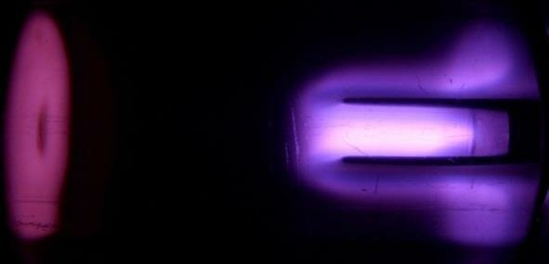

ION-I Scientific Visualization
Week 2 Meeting · Sep 20–26, 2026

Slide 2


This week's goals
Electric Propulsion Initiative - ION-I
Audit shared particle datasets and Gott & Xu cathode geometry
Define the engineering-geometry / field-data input format
Paper track: scope candidate topics, pick one
Deliverable: data & geometry inventory + import plan; paper topic selected
Fall 2026
2

Slide 3
Rough team split (4–5 people)
Electric Propulsion Initiative - ION-I
1 Data & geometry | Audit datasets, cathode geometry, define input format
2 Rendering env | Stand up PyVista / VTK / Trame in this repo
3 Paper | Scope topic candidates, start related-work scan
4 Homepage prep | Sketch scaffolding ahead of Week 3
Loose split — pair up as needed, sync Friday to merge into the repo
Fall 2026
3

Slide 4
Paper track & next week
Electric Propulsion Initiative - ION-I
Paper: literature review starts this week
Target venues (Spring 2027, if ready in time): Engineering Open House, Apr 9–10; Undergraduate Research Symposium, Apr 28–29
Next week (Sep 27–Oct 3): stand up rendering env, extend particle viz to engineering geometry/field data
Fall 2026
4

